Slide 1
Natural Language Processing (UE18CS334 CSE sixth semester)
Introduction Slide

Slide 2
Course logistics and course information
The execution plan

Slide 3
Instructor
Mrs. Ashwini M. Joshi
Email id: ashwinimjoshi@pes.edu
Submissions on: amj.nlp2019@gmail.com
Office: 2nd Floor Staff room

Slide 4
Pre-Requisite: UE18CS303-Machine Intelligence.

Slide 5
Course Objectives:
Learn the central themes, learning problem and the problem solving approaches used in NLP.
Learn various learning models related to sequence labeling that is the basic building block in NLP.
Learn how syntactic disambiguation is done in NLP.
Learn how lexical and distributional semantics can be used for semantic disambiguation in NLP.
Learn deep learning techniques and applications in Natural Language Processing

Slide 6
Course Outcomes:
At the end of this course, the student will be able to:
Have a very clear understanding of the central themes, central problem being solved in NLP and thelearning approaches used in solving them.
Get a grip on various sequence labeling approaches and applications in NLP.
Get a grip on how syntactic ambiguity removal can contribute in overall disambiguation process.
Apply comfortably and confidently appropriate branch of semantics depending on the problem beingsolved.
Learn how to implement neural language model, NLP applications using neural techniques andutilize various transfer learning approaches in NLP.

Slide 7
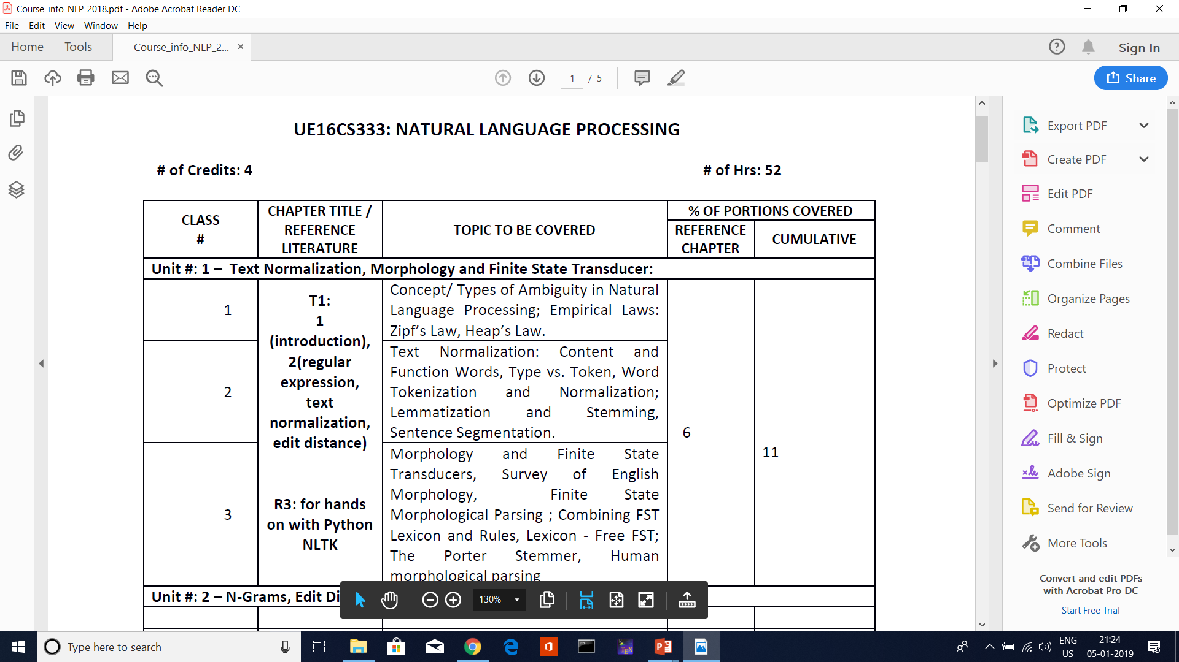
Course information vs. sequence of topics
You can refer to the course information circulated
We will follow the same sequence:
Idea is to become “hands on ready” as soon as possible so that we can do projects easily

Slide 8
Teacher vs. subject autonomy

Slide 9
Evaluation policy
ISA : ESA = 40 :60
ISA 1 : 40 scaled to 15 marks (CBT/Pen-Paper as per university policy).
ISA 2 : 40 scaled to 15 marks (CBT/Pen-Paper as per university policy). .
Assignment: 10 Marks (2 assignments for evaluation+ some handson assignment)
ESA Project : 20 marks
ESA theory: 100 Scaled to 40 marks ( pen & paper)
University attendance policy applicable.

Slide 10
Assignment evaluation : how
3 factors
Timeliness of submission
Working code
Quality of analysis
Assignments typically are open ended with little bit of analysis i.e. many possible correct answers

Slide 11
Project evaluation : how
4 factors
Timeliness of submission
Working code (Objective must meet)
Quantity of work
Novelty of idea
Marks will normally be Max, Med and Min for each of these three factors

Slide 12
What kind of course projects ?
Faculty may suggest some topics
You are most welcome to choose your topic
Some students pick up big topics. It is OK if it cannot be completed as long as you crisply define the deliverables for this semester
Deliverables : python jupyter notebook , data and 3-5 slides to explain to your class

Slide 13
Individual or team ?
Team of two will do all assignments as well as project
Why ?
Team learning and team effort ( it brings down the individual load)
Everybody contributes to remain fair to his team (ensures learning)
Brings down the individual load

Slide 14

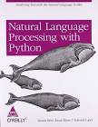
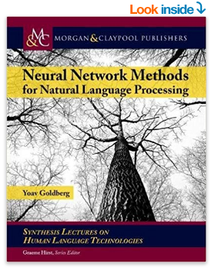
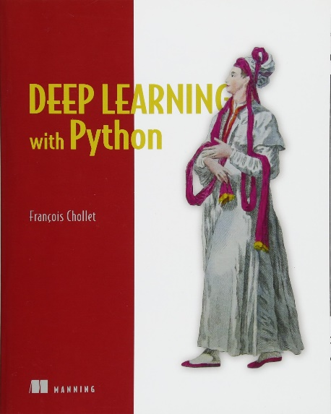
Text books & references
2
3
1
4
https://web.stanford.edu/~jurafsky/slp3/
http://www.nltk.org/book/
(1) Primary text : This is the 3rd and not yet published edition that we will use ; freely downloadable ; 2nd edition print copy available but many topics are not there
(2) Use it to learn NLTK in Python (3) Pdf may be available in net but essentially rely on your faculty
(4) Can be used for keras based coding. Alternatively you can just look at https://keras.io/

Slide 15
Question bank
No question bank will be provided.
Sample solved examples will be given
Paper pattern will be discussed and will be communicated to students 1 week prior to the exam.
List of topics will be shared apart from Lesson Plan.

Slide 16
Likely question pattern for theory
MCQ on theory concepts
Numerical problems
No need to memorize and write descriptive answers with diagrams
If you have studied well, you will have fun (;-

Slide 17
Software stack for nlp coding
Python 3 with anaconda stack
Jupyter notebook specifically for projects
Keras if we do something using NLP + deep neural net

Slide 18
Other optional resources for reference
Resources | Description
Stanford NLP course by Prof Dan Jurafsky & Chris Manning | https://www.youtube.com/playlist?list=PLiNErZ5Bus8qNxNsFZFkh-9_CzZRW9iH9
NLP course by Prof Dragomir Radev of University of Michigan | https://www.youtube.com/playlist?list=PLLssT5z_DsK8BdawOVCCaTCO99Ya58ryR
NLP by Prof Michael Collins (Columbia University) | https://www.youtube.com/user/afigfigueira/playlists?view=50&shelf_id=5&sort=dd
NLP by Prof Pushpak Bhattacharya (IIT Mumbai) | https://www.youtube.com/playlist?list=PLD392E2ACAEF0C689
Note : The slide set will borrow liberally from the above and many others

Slide 19
ML core course vs. NLP elective
There is overlap
NLP faculties will not teach ML theory and derivations. We will provide necessary background enough to explain what is going on and move forward.
ML projects cannot be claimed as NLP projects ( you can always reuse the knowledge and skill if applicable but cannot use the same project verbatim ).

